Slide 1

SAVEETHA INSTITUTE OF MEDICAL AND
TECHNICAL SCIENCES
BY :
AKSHITH(192311329)

Slide 2

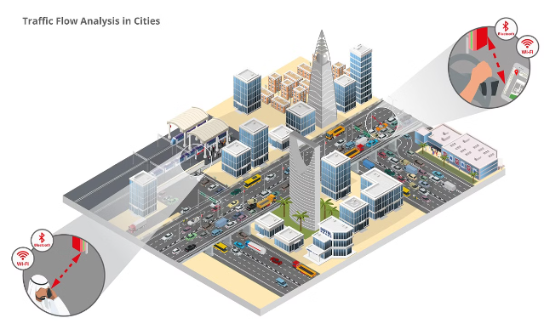
Smart Traffic Management with Forward-Firing Sensors
This presentation explores the potential of forward-firing sensors and pattern recognition algorithms in revolutionizing traffic management and enhancing urban mobility.

Slide 3

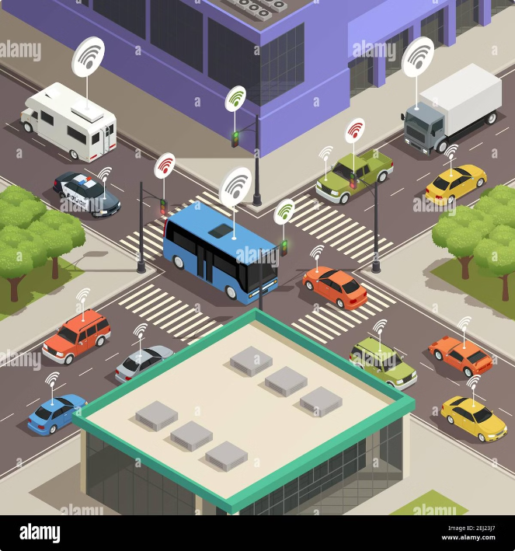
Introduction to Smart Traffic Management Technology
Smart traffic management aims to optimize traffic flow, reduce congestion, and improve road safety through technology. This technology employs sensors, cameras, and data analytics to gather and analyze real-time traffic information.
1
Real-Time Data Collection
Sensors collect data on traffic flow, speed, and congestion levels, providing a real-time snapshot of the traffic situation.
2
Traffic Pattern Recognition
Algorithms analyze this data to identify traffic patterns, congestion hotspots, and potential bottlenecks.
3
Dynamic Traffic Control
The system dynamically adjusts traffic signals, speed limits, and routing guidance based on real-time conditions.
4
Improved Road Safety
Real-time monitoring and alerts help prevent accidents and optimize emergency response.

Slide 4
Challenges of Traditional Traffic Management
Traditional traffic management systems often struggle to cope with the complexities of modern urban environments. These systems often lack the real-time data and dynamic adaptability required for efficient traffic flow management.
Static Traffic Signals
Limited Data Availability
Inefficient Response Times
Traffic lights operate on fixed schedules, which may not effectively address fluctuations in traffic flow.
Traditional systems rely on limited data sources, such as loop detectors, which provide a narrow view of traffic conditions.
Manual interventions and limited data availability can lead to slow responses to traffic incidents and congestion.

Slide 5

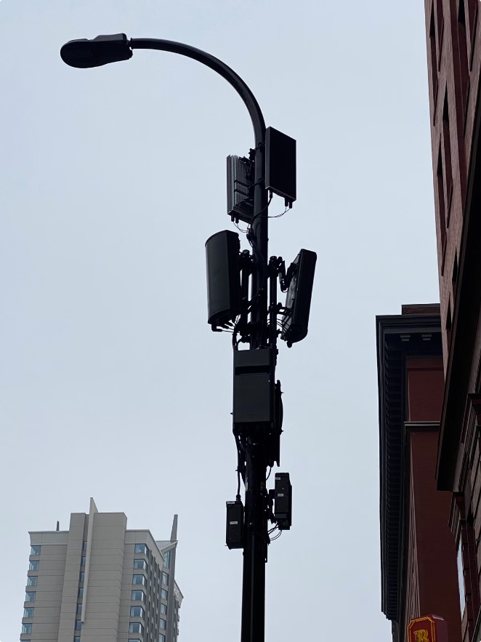
The Role of Forward-Firing Sensors
Forward-firing sensors are a crucial component of smart traffic management systems. These sensors, typically mounted on street poles or overpasses, use radar or lidar technology to gather real-time data on traffic flow and vehicle characteristics.
1
Data Collection
Sensors capture data on vehicle speed, distance, direction, and lane occupancy.
2
Data Transmission
Sensor data is transmitted to a central processing unit for analysis and interpretation.
3
Traffic Optimization
The system analyzes the data to optimize traffic flow, adjust signal timings, and provide real-time routing guidance.

Slide 6

Pattern Recognition Algorithms for Traffic Data Analysis
Advanced pattern recognition algorithms are used to extract valuable insights from the data collected by forward-firing sensors. These algorithms identify patterns in traffic flow, congestion hotspots, and potential bottlenecks.
Algorithm Type
Function
Clustering Algorithms
Identify groups of vehicles with similar characteristics, such as speed or direction.
Regression Models
Predict traffic flow and congestion levels based on historical data and real-time observations.
Machine Learning Techniques
Train models to identify anomalies and predict future traffic events.

Slide 7

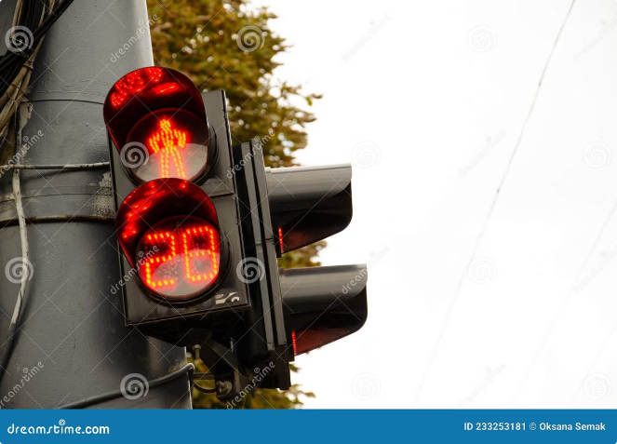



Enhancing Traffic Flow with Predictive Capabilities
By analyzing traffic patterns and historical data, smart traffic management systems can predict future congestion and optimize traffic flow in advance.
Traffic Prediction
Algorithms predict future traffic conditions based on real-time data and historical patterns.
Adaptive Traffic Control
The system adjusts traffic signal timings, speed limits, and routing guidance to optimize traffic flow based on predictions.
Dynamic Route Guidance
Drivers are provided with real-time route guidance and traffic alerts to avoid congestion and optimize travel time.

Slide 8


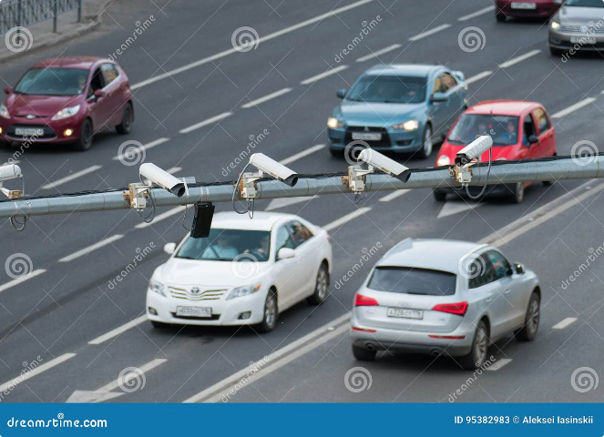



Improving Road Safety Through Real-Time Monitoring
Forward-firing sensors and real-time data analysis enable proactive safety measures to prevent accidents and optimize emergency response.
Accident Detection
Sensors can detect sudden changes in traffic flow or vehicle behavior, indicating potential accidents.
Emergency Response
Real-time data allows for faster and more efficient dispatch of emergency services.
Speed Monitoring
The system can identify speeding vehicles and enforce speed limits to prevent accidents.
Lane Departure Alerts
Sensors can detect lane departures and alert drivers to avoid accidents.

Slide 9
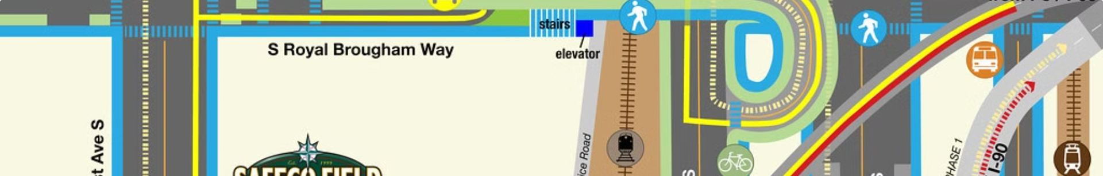
Integrating Smart Traffic Management with Urban Planning
Smart traffic management systems play a crucial role in supporting sustainable urban development and efficient city planning.
Urban Design
Traffic Demand Management
Sustainable Mobility
Traffic data insights can inform the design of new roads, intersections, and public transportation networks.
Smart traffic management systems contribute to a more efficient and sustainable transportation system, reducing emissions and improving air quality.
The system can encourage alternative modes of transportation, such as cycling or public transit, to reduce traffic congestion.

Slide 10



Overcoming Technical and Infrastructural Barriers
The implementation of smart traffic management systems requires careful consideration of technical and infrastructural challenges.
Sensor Deployment
Traffic Signal Synchronization
Infrastructure Upgrades
Strategic placement and maintenance of sensors are essential for accurate data collection.
Existing infrastructure may need upgrades to accommodate new sensors and data communication systems.
Integration with existing traffic signal systems requires careful planning and coordination.

Slide 11

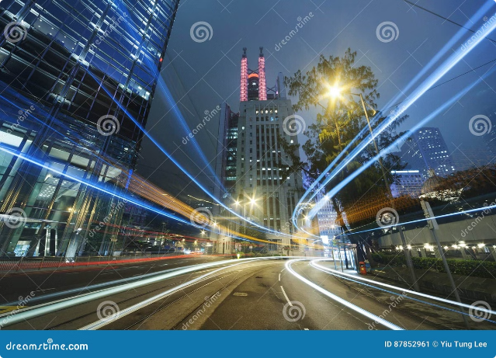
Conclusion
Smart traffic management technology holds immense potential for optimizing urban mobility and enhancing road safety. Forward-firing sensors and pattern recognition algorithms provide valuable insights into traffic behavior, enabling real-time traffic control, predictive capabilities, and improved safety measures. Overcoming technical and infrastructural challenges is crucial for successful implementation and realizing the full potential of this transformative technology.

